Slide 1

RETAIL SALES ANALYSIS
Presented by:
Karrolla Bhojavva

Slide 2
About Me
Background
B.Sc. Graduated in Mathematics,Statistics and Computers from Veeranari Chakali Ilamma University
.
Area of interest
  Data Analytics and Business intelligence using
  Python, SQL, Pandas, Exploratory Data Analysis(EDA)
Work Experience/ Training
Fresher
Profiles
https://www.linkedin.com/in/karrolla-bhojavva/
https://github.com/keer687

Slide 3
AGENDA
Business Problem
Project Objectives
Data Information & Data Cleaning
Exploratory Data Analysis (EDA)
Business Analysis & Key Insights
Outlier Analysis
Pandas
Probability Analysis
Challenges & experiences
Recommendations & conclusion
Business Problem Statement
Identify the best-selling product categories and most frequently ordered products.
Analyze customer segments, loyalty membership, and purchasing behavior.
Find high-performing cities and understand customer payment preferences.

Slide 4
Project Objectives
Analyze customer behavior, product performance, and sales patterns using Python, SQL, and EDA.
Identify key trends, detect outliers, and evaluate customer purchasing patterns.
Provide data-driven recommendations to improve sales and inventory management.
Data Information
Dataset Overview
Customers: Customer ID, gender, age, city, signup date, loyalty membership.
Orders: Order ID, customer ID, product ID, order date, quantity, payment method.
Products: Product ID, product name, category, price
.
Tools Used
Python (Pandas) , SQL, Matplotlib and Seaborn
Dataset | Rows | Columns
Customers | 1,200 | 6
Orders | 4,000 | 6
Products | 80 | 4

Slide 5
Data Quality and Validation
1. Duplicate Check
Checked all three tables for duplicate records.
No duplicate rows were found in customers, orders, or products.
2. Missing Values
Checked all tables for missing values.
No missing values were found in any of the three tables.
3. Data Type Validation
Converted date columns to datetime format.
Converted categorical columns to category data type.
Verified numerical columns such as age, quantity, and price.
4. Data Quality Validation
Verified data types and checked for duplicates and missing values.
The dataset is ready for further exploratory data analysis (EDA).

Slide 6
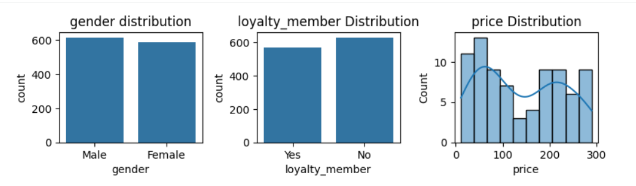
EDA – Univariate Analysis:
Gender Distribution
Male customers are slightly higher than female customers.
Customer distribution is nearly balanced by gender.
Loyalty Member Distribution
Non-loyalty members are higher in number.
More customers could be encouraged to join the loyalty program.
Price Distribution
Most prices are concentrated in the lower range.
Prices show another concentration around 200–250.

Slide 7
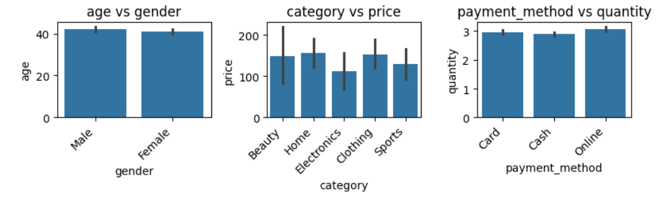
EDA – Bivariate Analysis:
Age vs gender
Male customers have a slightly higher average age.
Both genders have similar average ages.
Category vs Price
Home has the highest average price.
Electronics has the lowest average price.
Payment Method vs Quantity
Online payments have the highest average quantity.
Cash payments have the lowest average quantity.

Slide 8
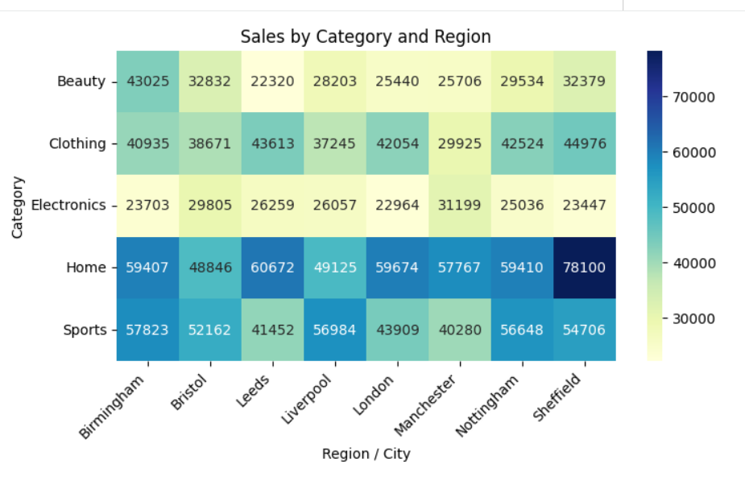
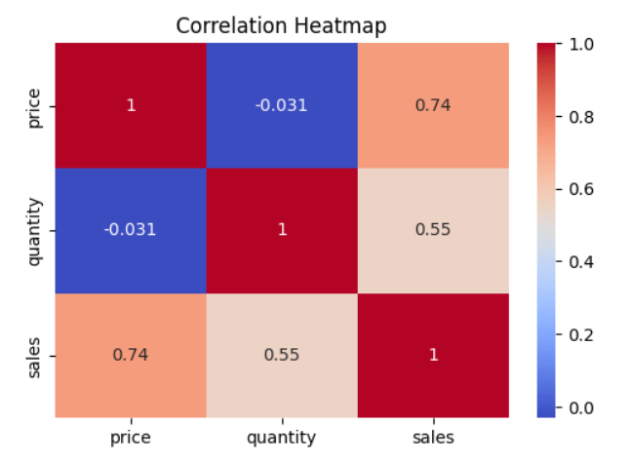
EDA – Multivariate Analysis:
1.Which numerical variables are correlated with each other?
2.Which product categories perform best in each region?
Correlation Heatmap
Strong positive correlation indicates two variables tend to increase together.
Strong negative correlation indicates one variable tends to decrease as the other increases.
Sales by Category and Region
Identify the region generating the highest sales for each product category.
Low sales in a region may indicate an opportunity for targeted promotions.

Slide 9
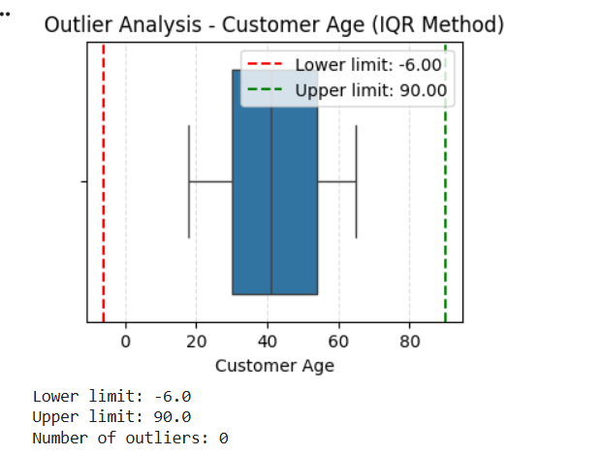
Outliers Handling
  Customer ages range from 18 to 65 years, with an average age of approximately 42.
  No age outliers were detected using the IQR method.
  Customer ages appear reasonable, so no outlier removal is needed for this column.

Slide 10
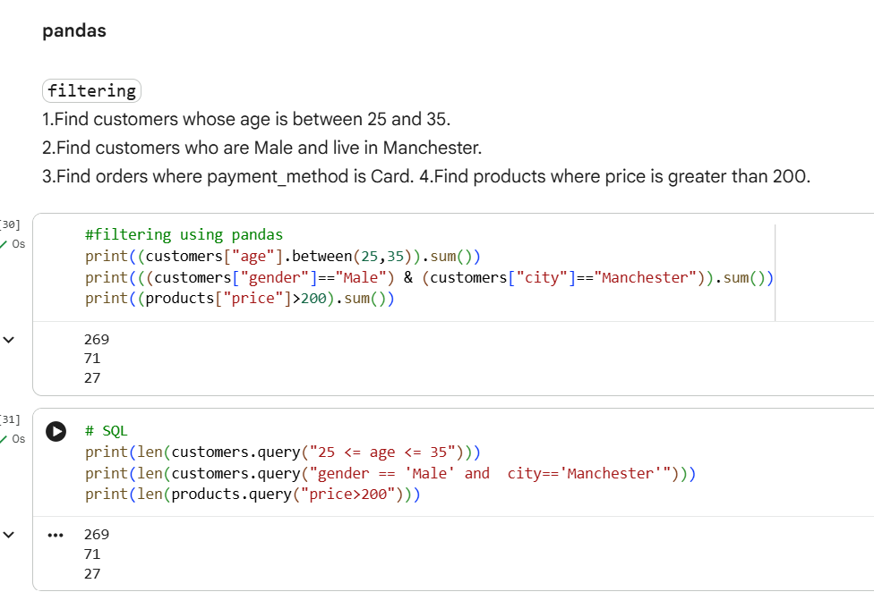
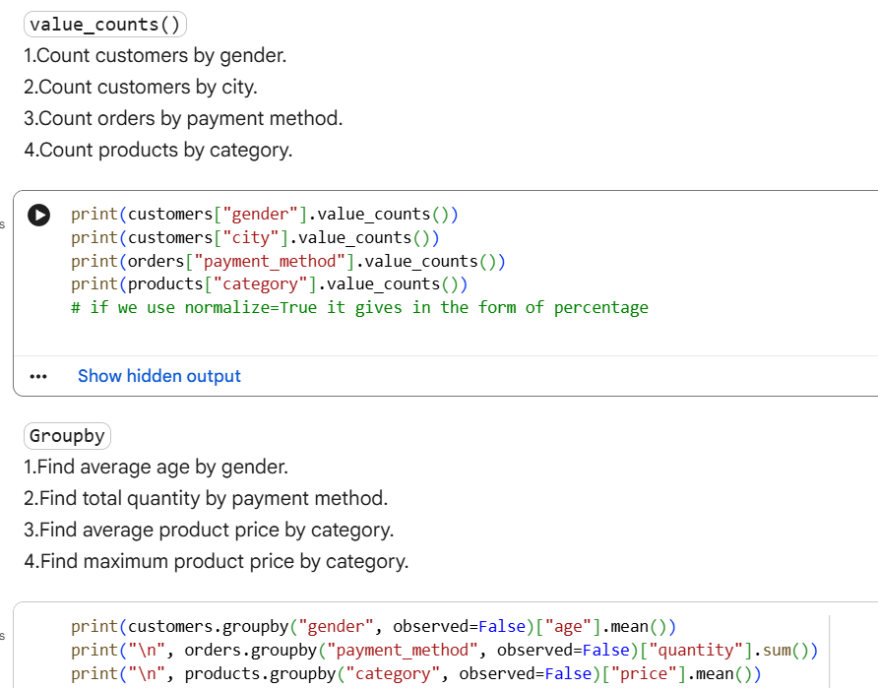
Pandas

Slide 11
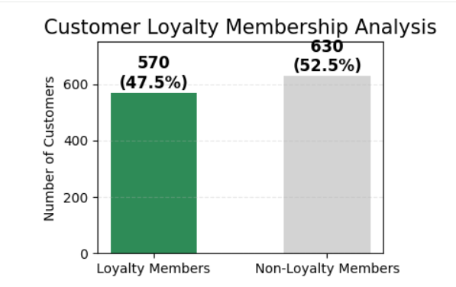
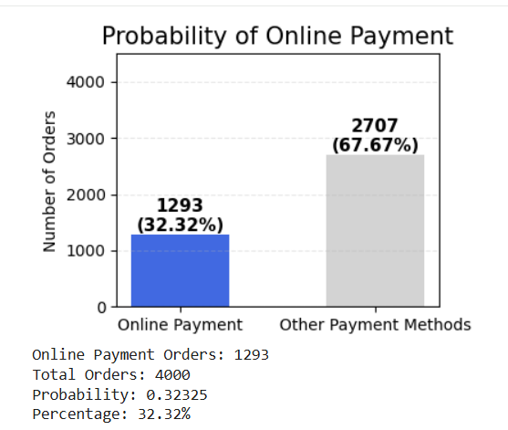
Probability Analysis
Q1. What is the probability that a randomly selected customer is a loyalty member?
What is the probability that a randomly selected order uses the Online payment method?
Key-insights:
Measures the likelihood of customers being loyalty members.
Identifies the probability of orders using online payments.
Helps understand customer behavior and payment preferences.
Supports data-driven business decisions.

Slide 12
Challenges and Experiences
Experience
Gained practical experience in Python, Pandas, SQL, EDA, data visualization, and probability analysis.
Challenges
converting data types, identifying outliers, and interpreting results.
Learning
Learned how to transform raw data into meaningful insights that support data-driven business decisions.
project outcome
Analyzed customer behavior, product sales, payment preferences, and loyalty patterns to identify useful business insights.

Slide 13
Recommendations
Maintain sufficient stock of best-selling products to meet customer demand.
Offer discounts and promotions for low-performing products.
Strengthen customer loyalty programs with rewards and exclusive offers.
Improve marketing strategies based on customer preferences and buying behavior.
Optimize payment options to provide customers with greater convenience.
Analyze sales trends regularly to improve inventory planning.
Use data-driven insights to improve customer satisfaction and business growth.

Slide 14
Conclusion:
This project helped me analyze customer behavior and identify meaningful business insights.
I gained practical experience in Python, Pandas, SQL, EDA, and probability analysis.
I learned to handle missing values, duplicates, data types, and outliers.
I faced challenges in data cleaning and interpreting results, which improved my problem-solving skills.
Overall, this project enhanced my analytical skills and taught me how to make data-driven business decisions.

Slide 15

THANK YOU

